Slide 1
PythonDaySeven -while loop for loop
PoHanWu
20190205

Slide 2
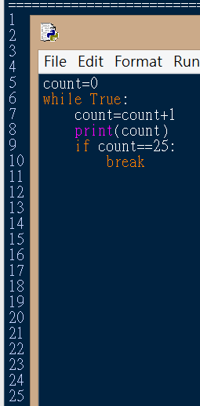
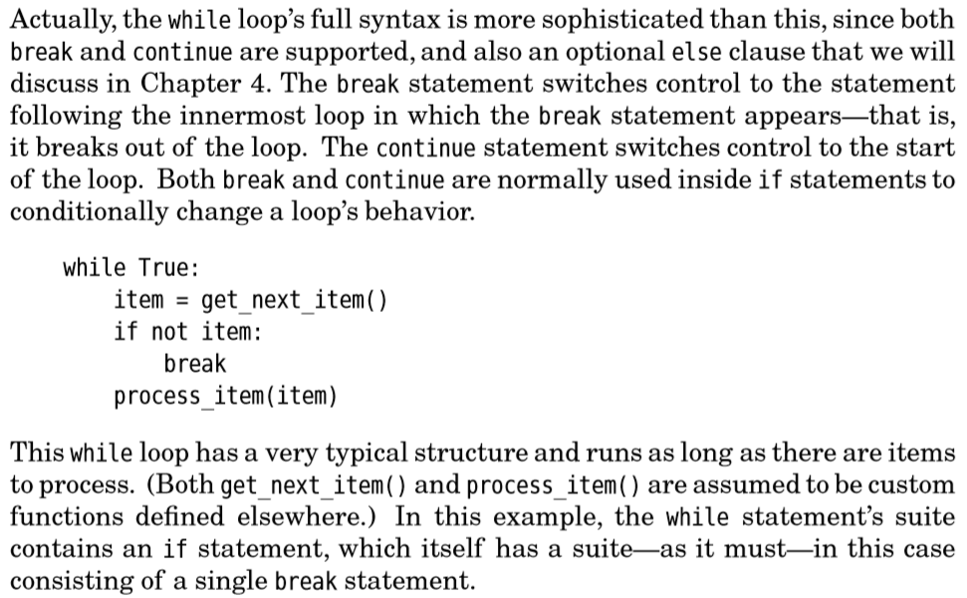
while

Slide 3

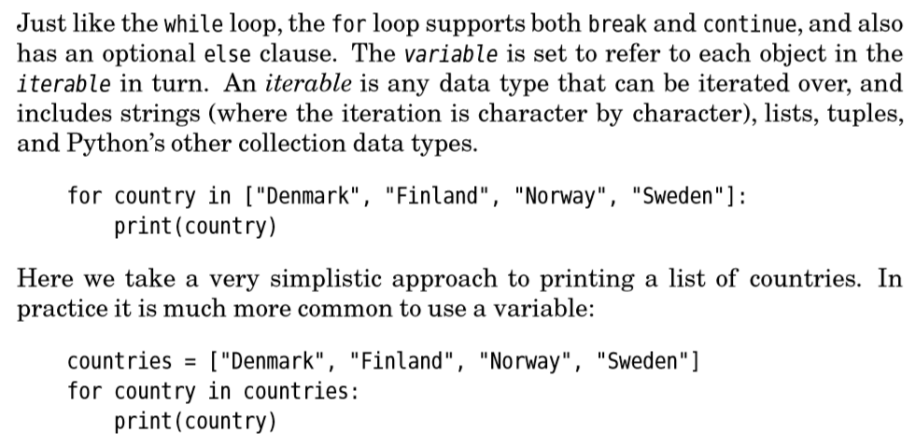

For loop reuse “in”

Slide 4

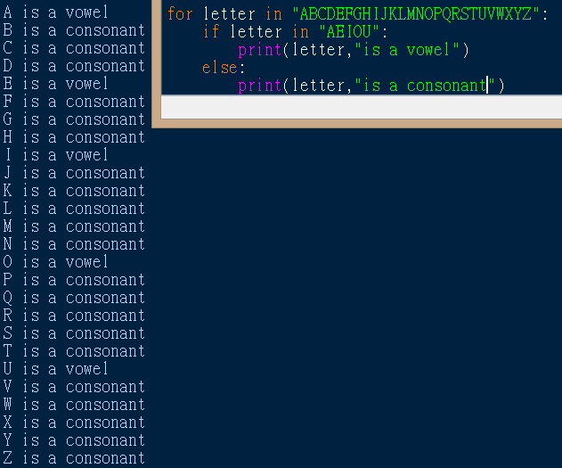
For loop

